Slide 1
Practical Electronics: “Gameboy”
PE5: Tangat Baktybergen and Towfiqur Rahman Khan

Slide 2
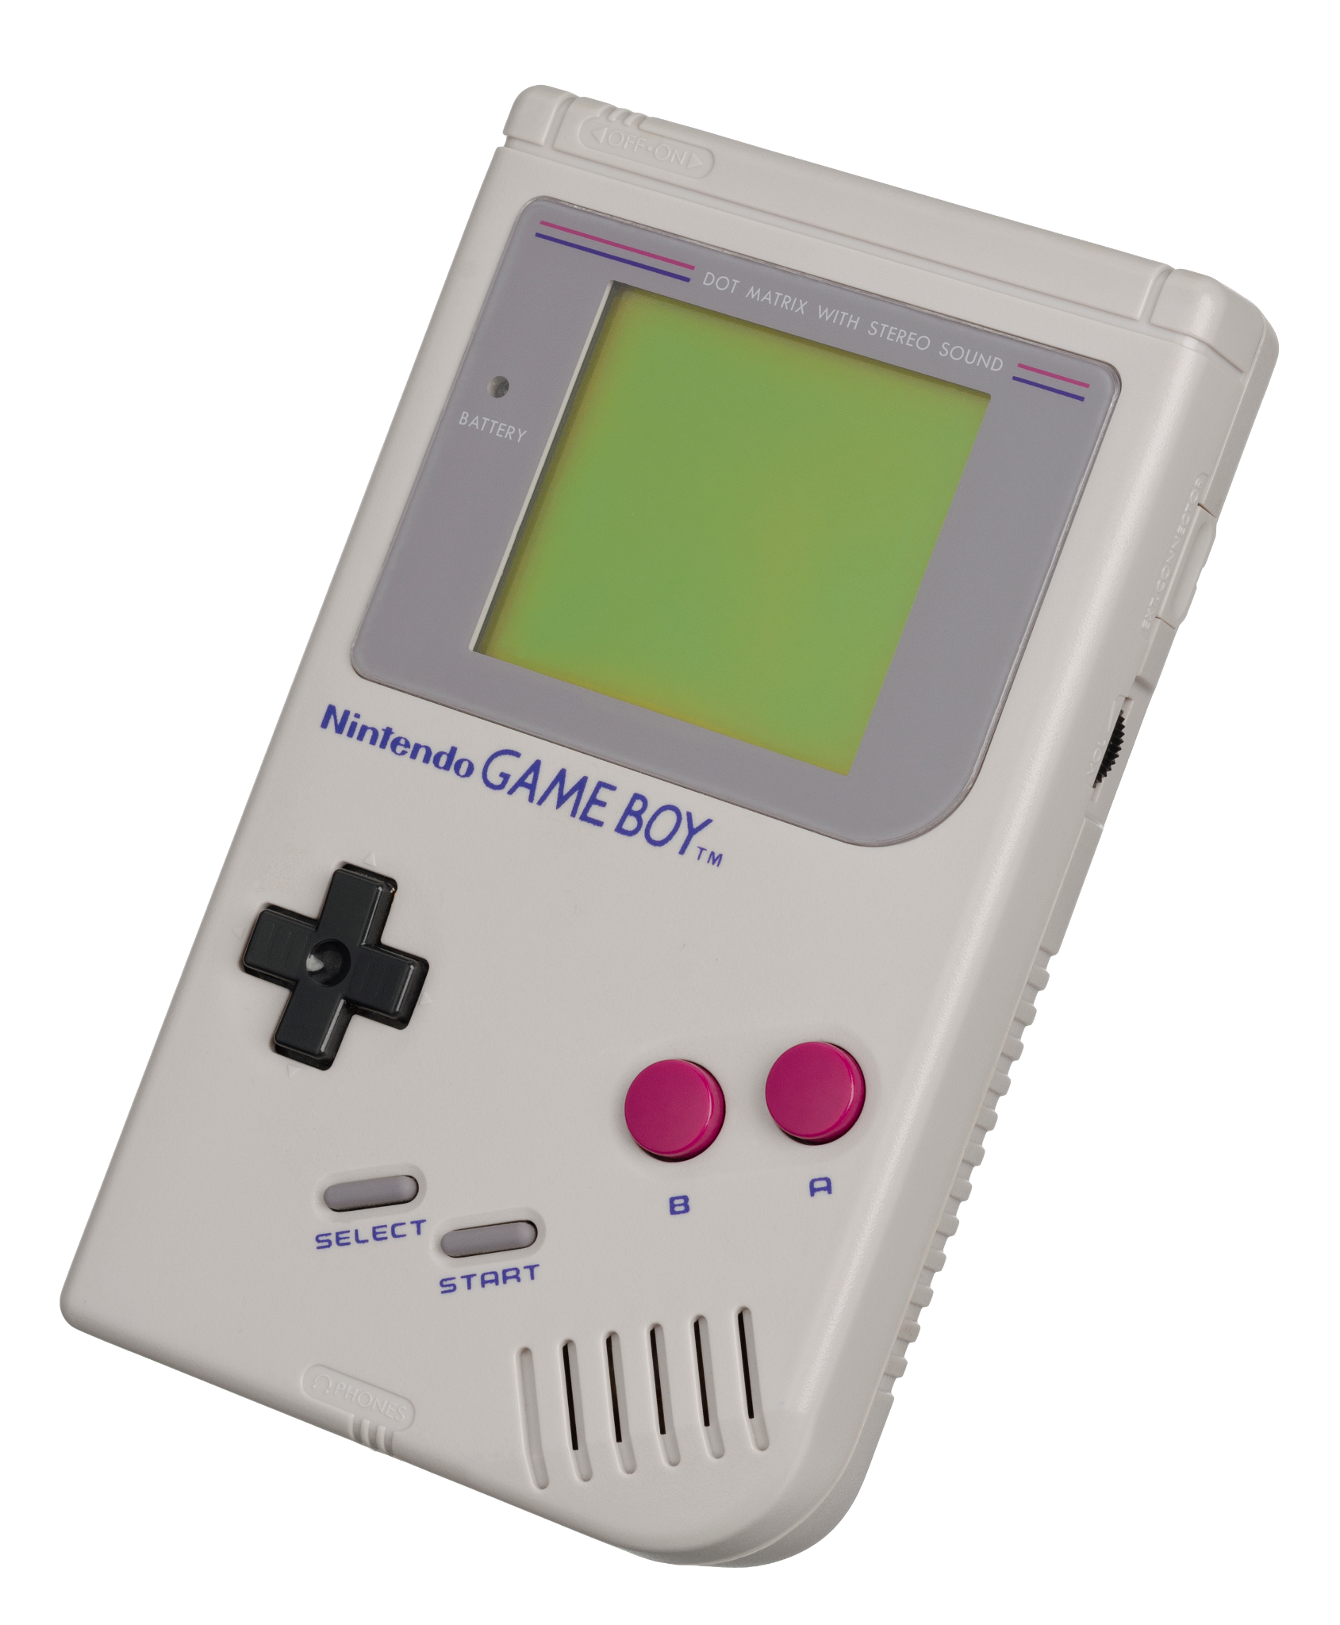
Historical background:
Made by Nintendo
Had 2 “A” , “B” buttons and “+” direction pad.
2 bit colour 2.6 inch (7cm) display and 1 speaker
4 AA batteries
https://en.wikipedia.org/wiki/File:Game-Boy-FL.jpg

Slide 3
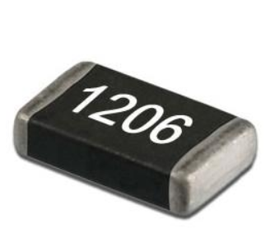
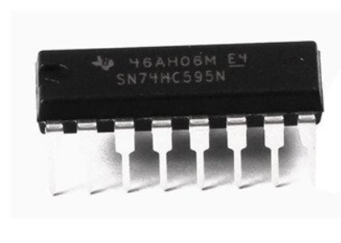
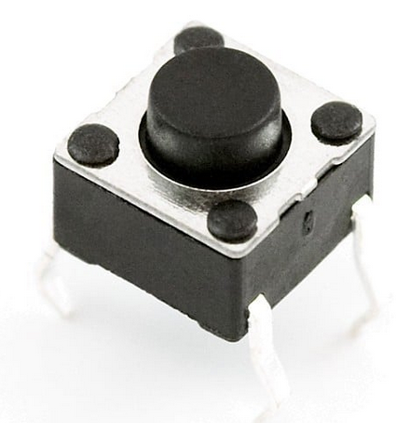
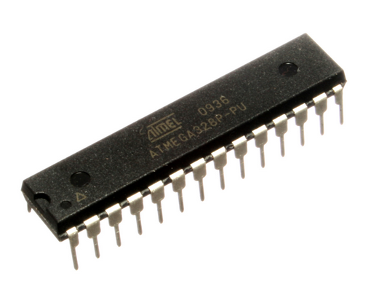
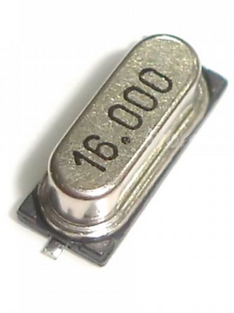
Hardware
3 of SN74HC595 - shift register ( SiPo)
23 of resistors
10 uF capacitor
Speaker
5 push buttons
16 MHz crystal
2 x22pF capacitor
8 x NPN transistors
2 x 8x8 dot matrix display
https://www.exp-tech.de/zubehoer/tasterschalter/4342/mini-push-button-switch-20-pack
https://calcuttaelectronics.com/product/1206-smd-resistor-multiple-value-1k10k-1-4-watt/
https://en.wikipedia.org/wiki/ATmega328

Slide 4
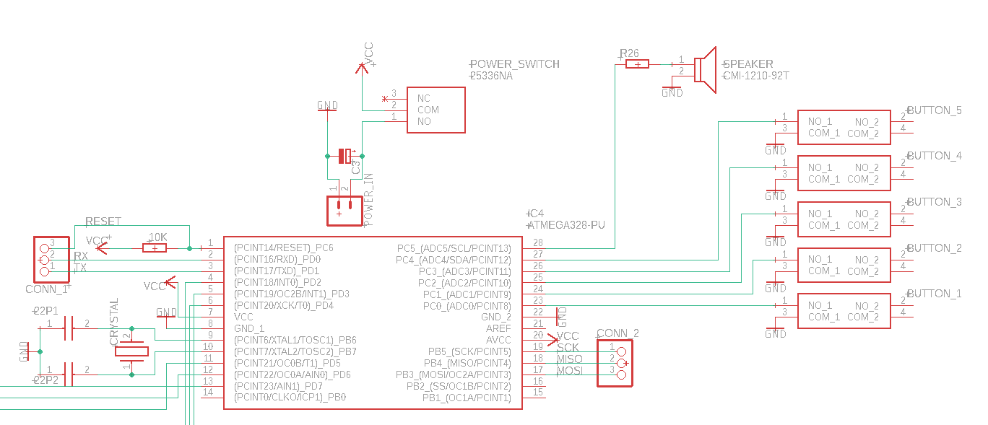
Circuit: Microcontroller I/O

Slide 5
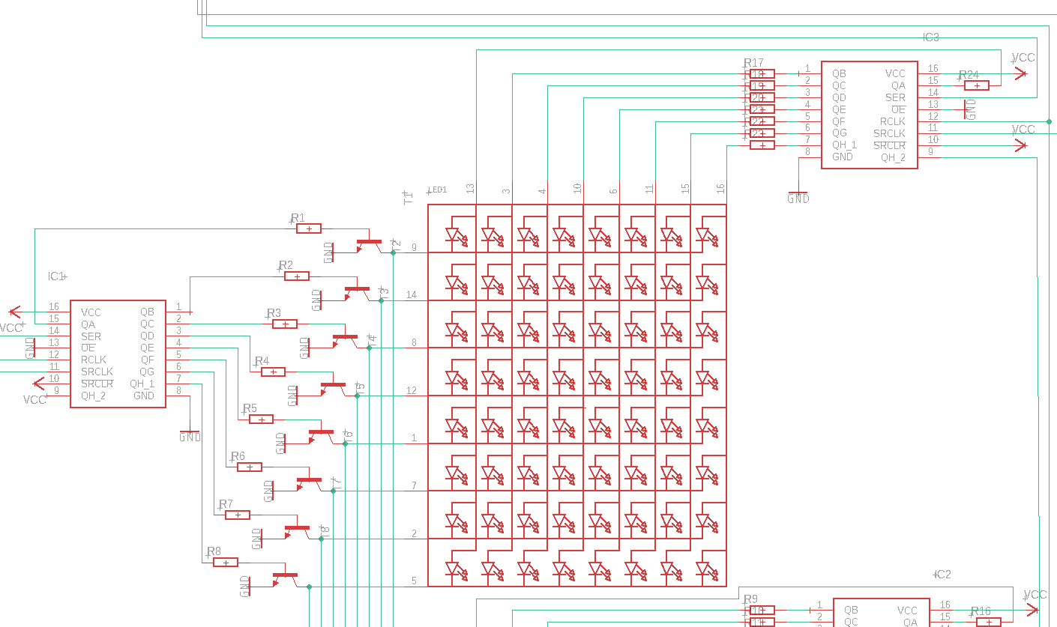
Circuit: Matrix display and shift registers

Slide 6
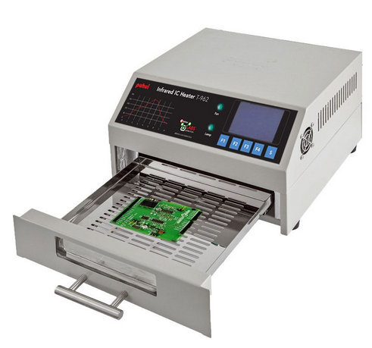
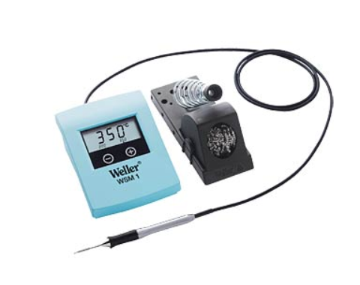
Assembling
https://www.elektor.de/infrared-reflow-oven-t-962-revised-elektor-version reichelt:solder station

Slide 7
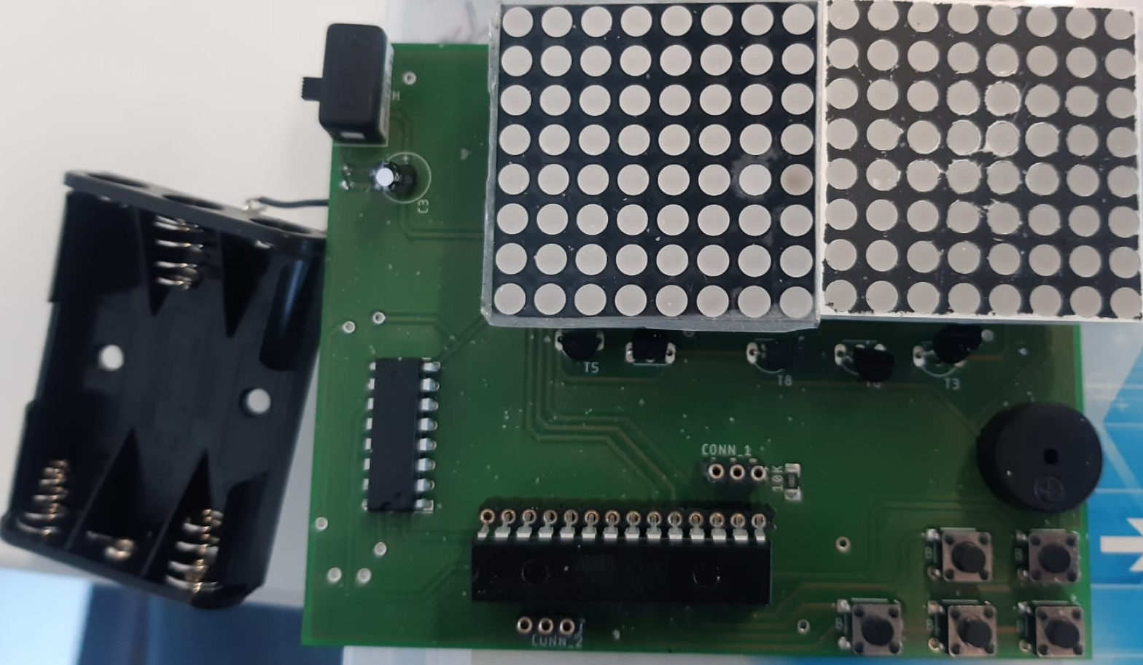
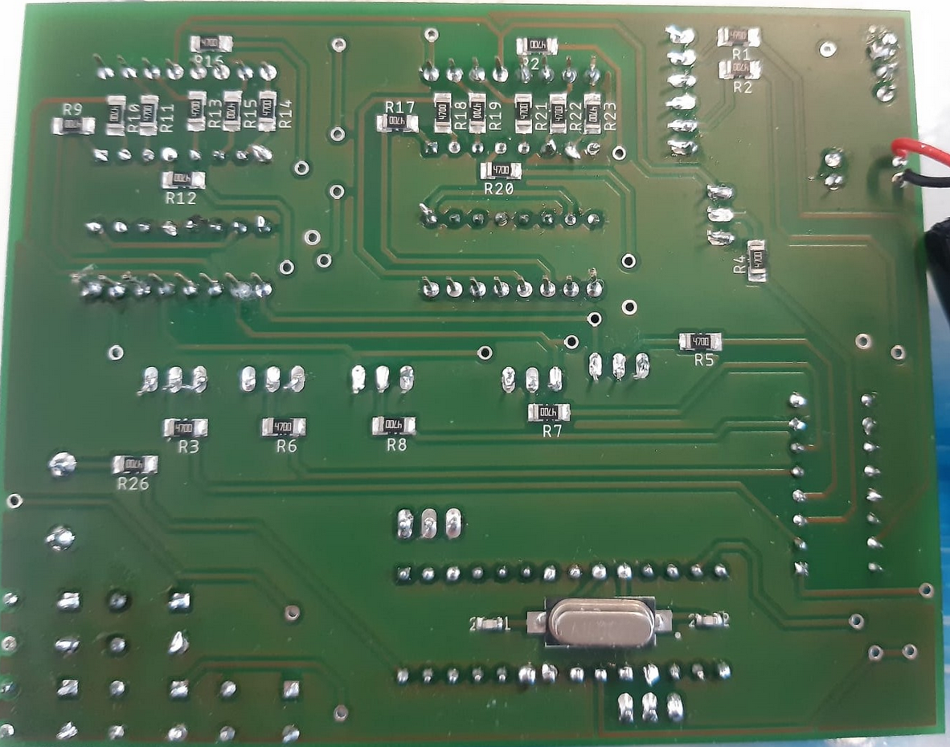
PCB after assembling
Top view
Bottom view

Slide 8
Problems we faced: Hardware
Display
Datasheet
Eagle library
ATMega328
Size
Stock
Small size PCB
Track size
Isolation size
Too many components
Shift registers instead of LED drivers (MAX7219)

Slide 9
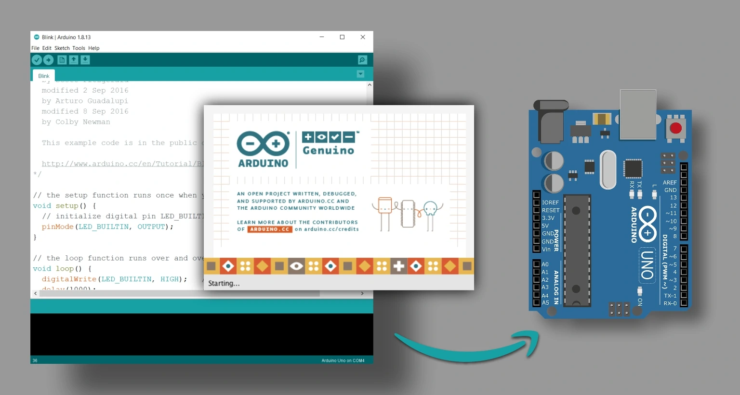
Software
Open-source electronics platform
Simple hardware and software
IDE with C/C++
Past experience
https://www.techtonions.com/getting-familiar-with-arduino-ide/

Slide 10
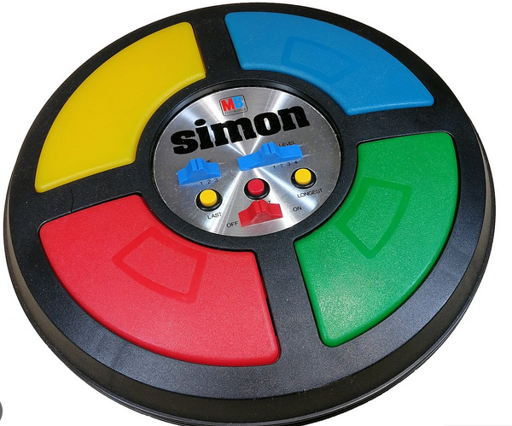
The Game “Simon Says”
A random pattern of symbols are created
The symbols are showed to the player
The player should remember the sequence and recreate by pushing respective buttons
https://en.wikipedia.org/wiki/Simon_%28game%29

Slide 11

Demonstration of the Gameboy

Slide 12
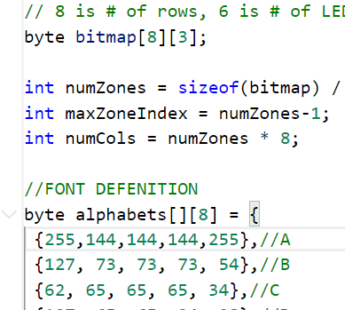
Display boundaries and symbols
Byte array to define rows and columns
[8][1] as one matrix display
Byte alphabets stores symbols(enables row LEDs)
Example : 255 enable all LEDs on first column
1 / 2 / 4 / 8 / 16 / 32 / 64 / 128

Slide 13
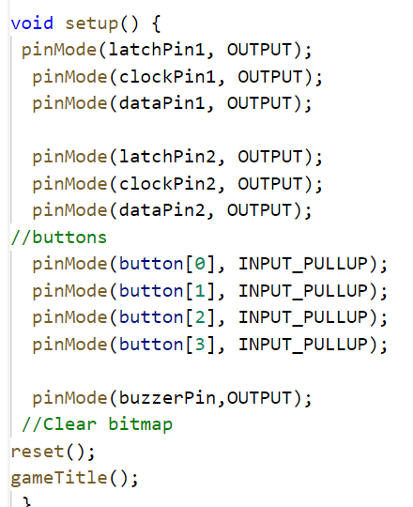
setup() - initialization
Define column and row shift register inputs
Clock
Latch
Data
Define buttons
Define buzzer
As it runs one time , clear display and show the game title

Slide 14
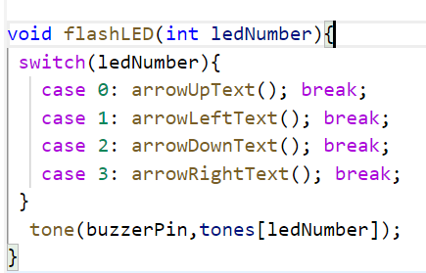
Sub-function: flashLED()
Calls one of the functions to the show the arrow symbol on display

Slide 15
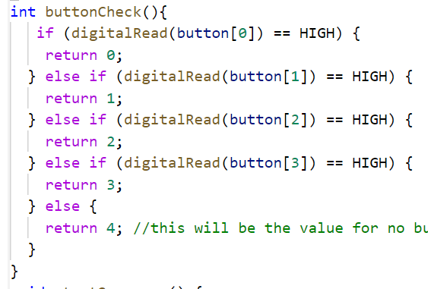
Sub-function: buttonCheck()
Checks which control button is pressed

Slide 16
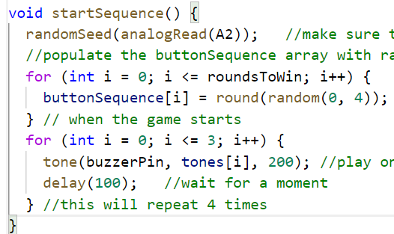
Sub-function: startSequence()
Create a random value between 0 and 4 and fill the buttonSequence with it.

Slide 17
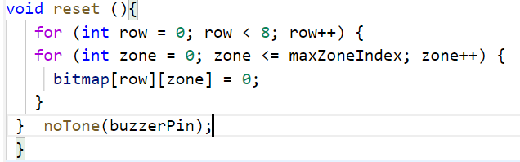
Sub-function: reset()
Clean the display and disable buzzer

Slide 18
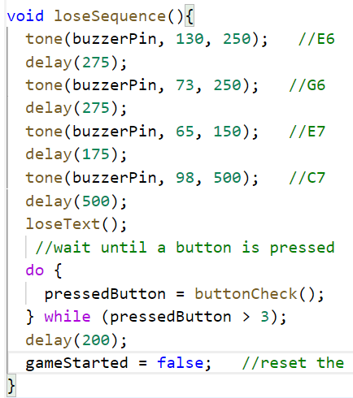
Void loop(): loseSequence()
Play losing condition sound and wait till any button is pressed

Slide 19
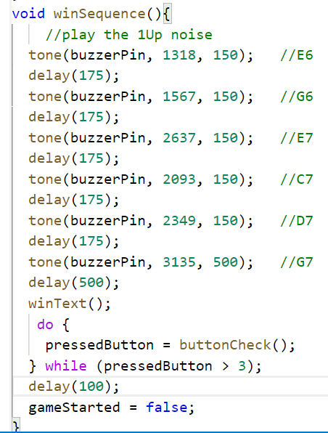
Void loop(): winSequence()
Play winning condition sound and wait till any button is pressed

Slide 20
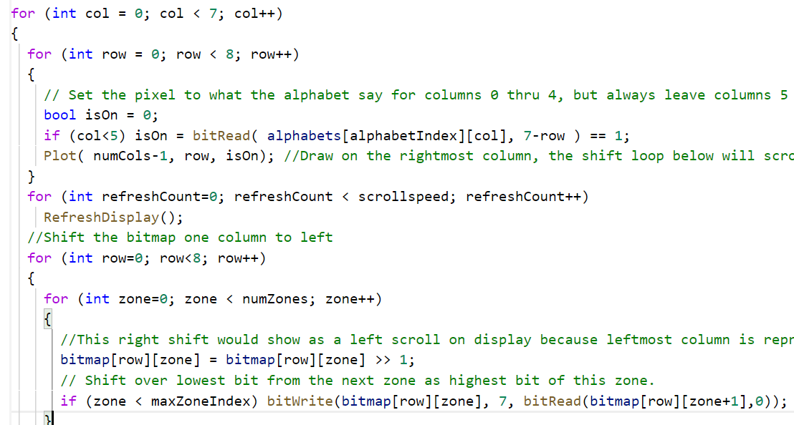
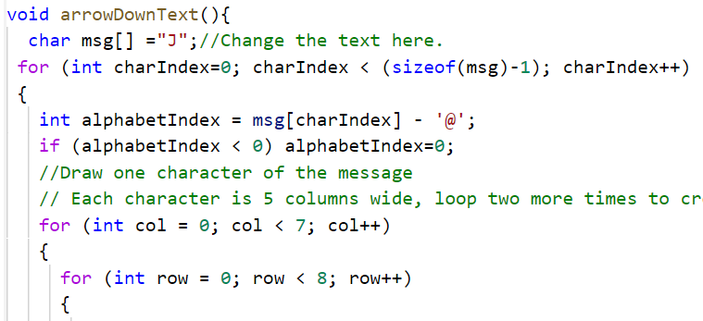
Void loop(): arrowDownText()
arrowUpText() , arrowRightText(), arrowLeftText() and gameTitel(),loseText(),winText() have same code but different symbol.

Slide 21
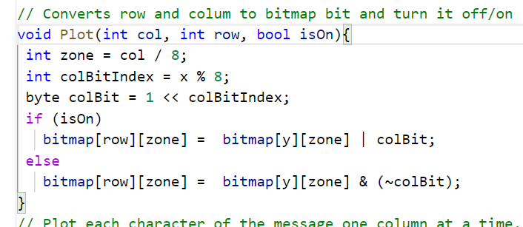
Sub-function:Plot()
Converts rows and column to bitmap bit
and turn it off/on. Plot each character of the message one column at a time. Update the display and shift bitmap left.

Slide 22
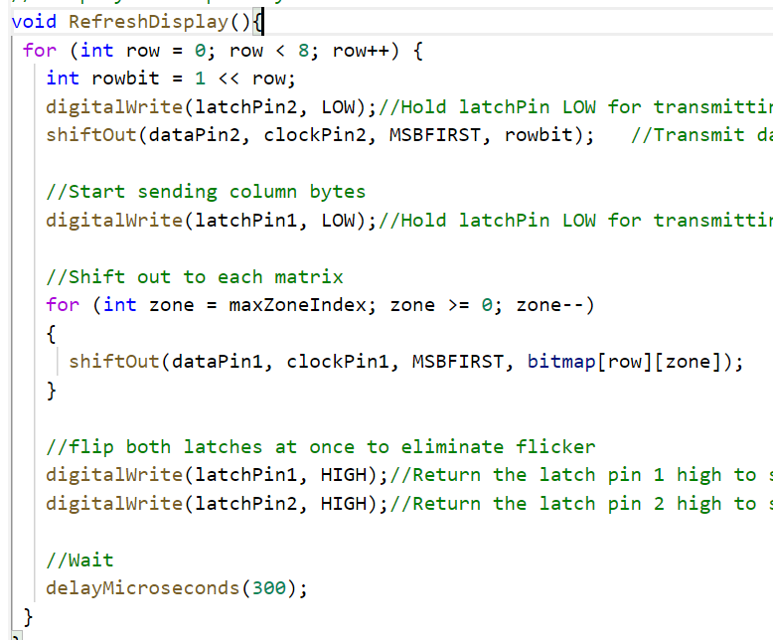
Sub-function:RefreshDisplay()
Shift out the symbol from alphabet byte array

Slide 23
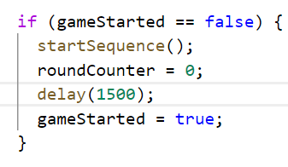
Void loop(): step 1
Check “gameStarted” flag
False as “game not started” and True as “game start”
Call startSequence()
Reset roundCounter
Stop the loop : set gameStarted true

Slide 24
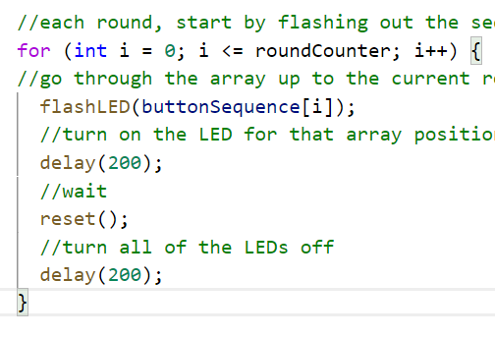
Void loop(): step 2
Each round start by showing the symbols from the randomly created sequence.

Slide 25
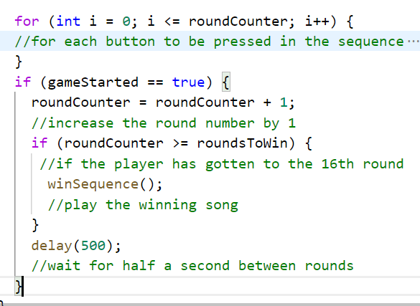
Void loop(): step 3
Start going through the sequence and check if player presses correct buttons.

Slide 26
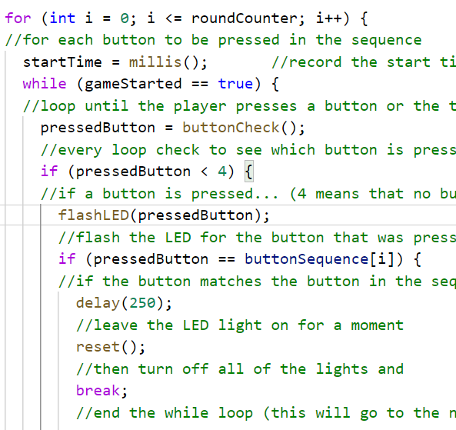
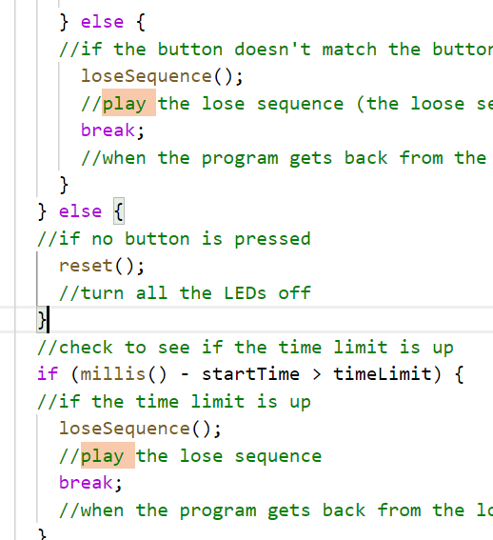
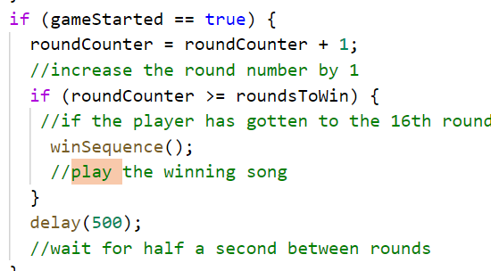
Void loop(): step 4

Slide 27
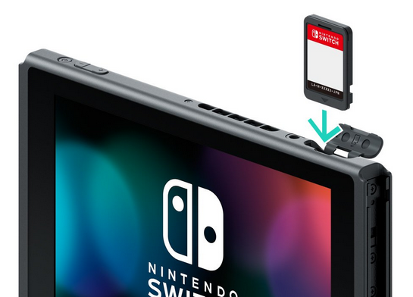
Solutions and Future:
Library to control display
Plug and Play
Ready game cards
Plug any game card and start playing instantly
Change all components to SMD
Save space
Change UI and design
Button replacement
RGB display
https://www.gamepro.de/artikel/mehr-speicher-weniger-downloads-switch-koennte-2020-groessere-game-cards-kriegen,3352711.html

